Slide 1
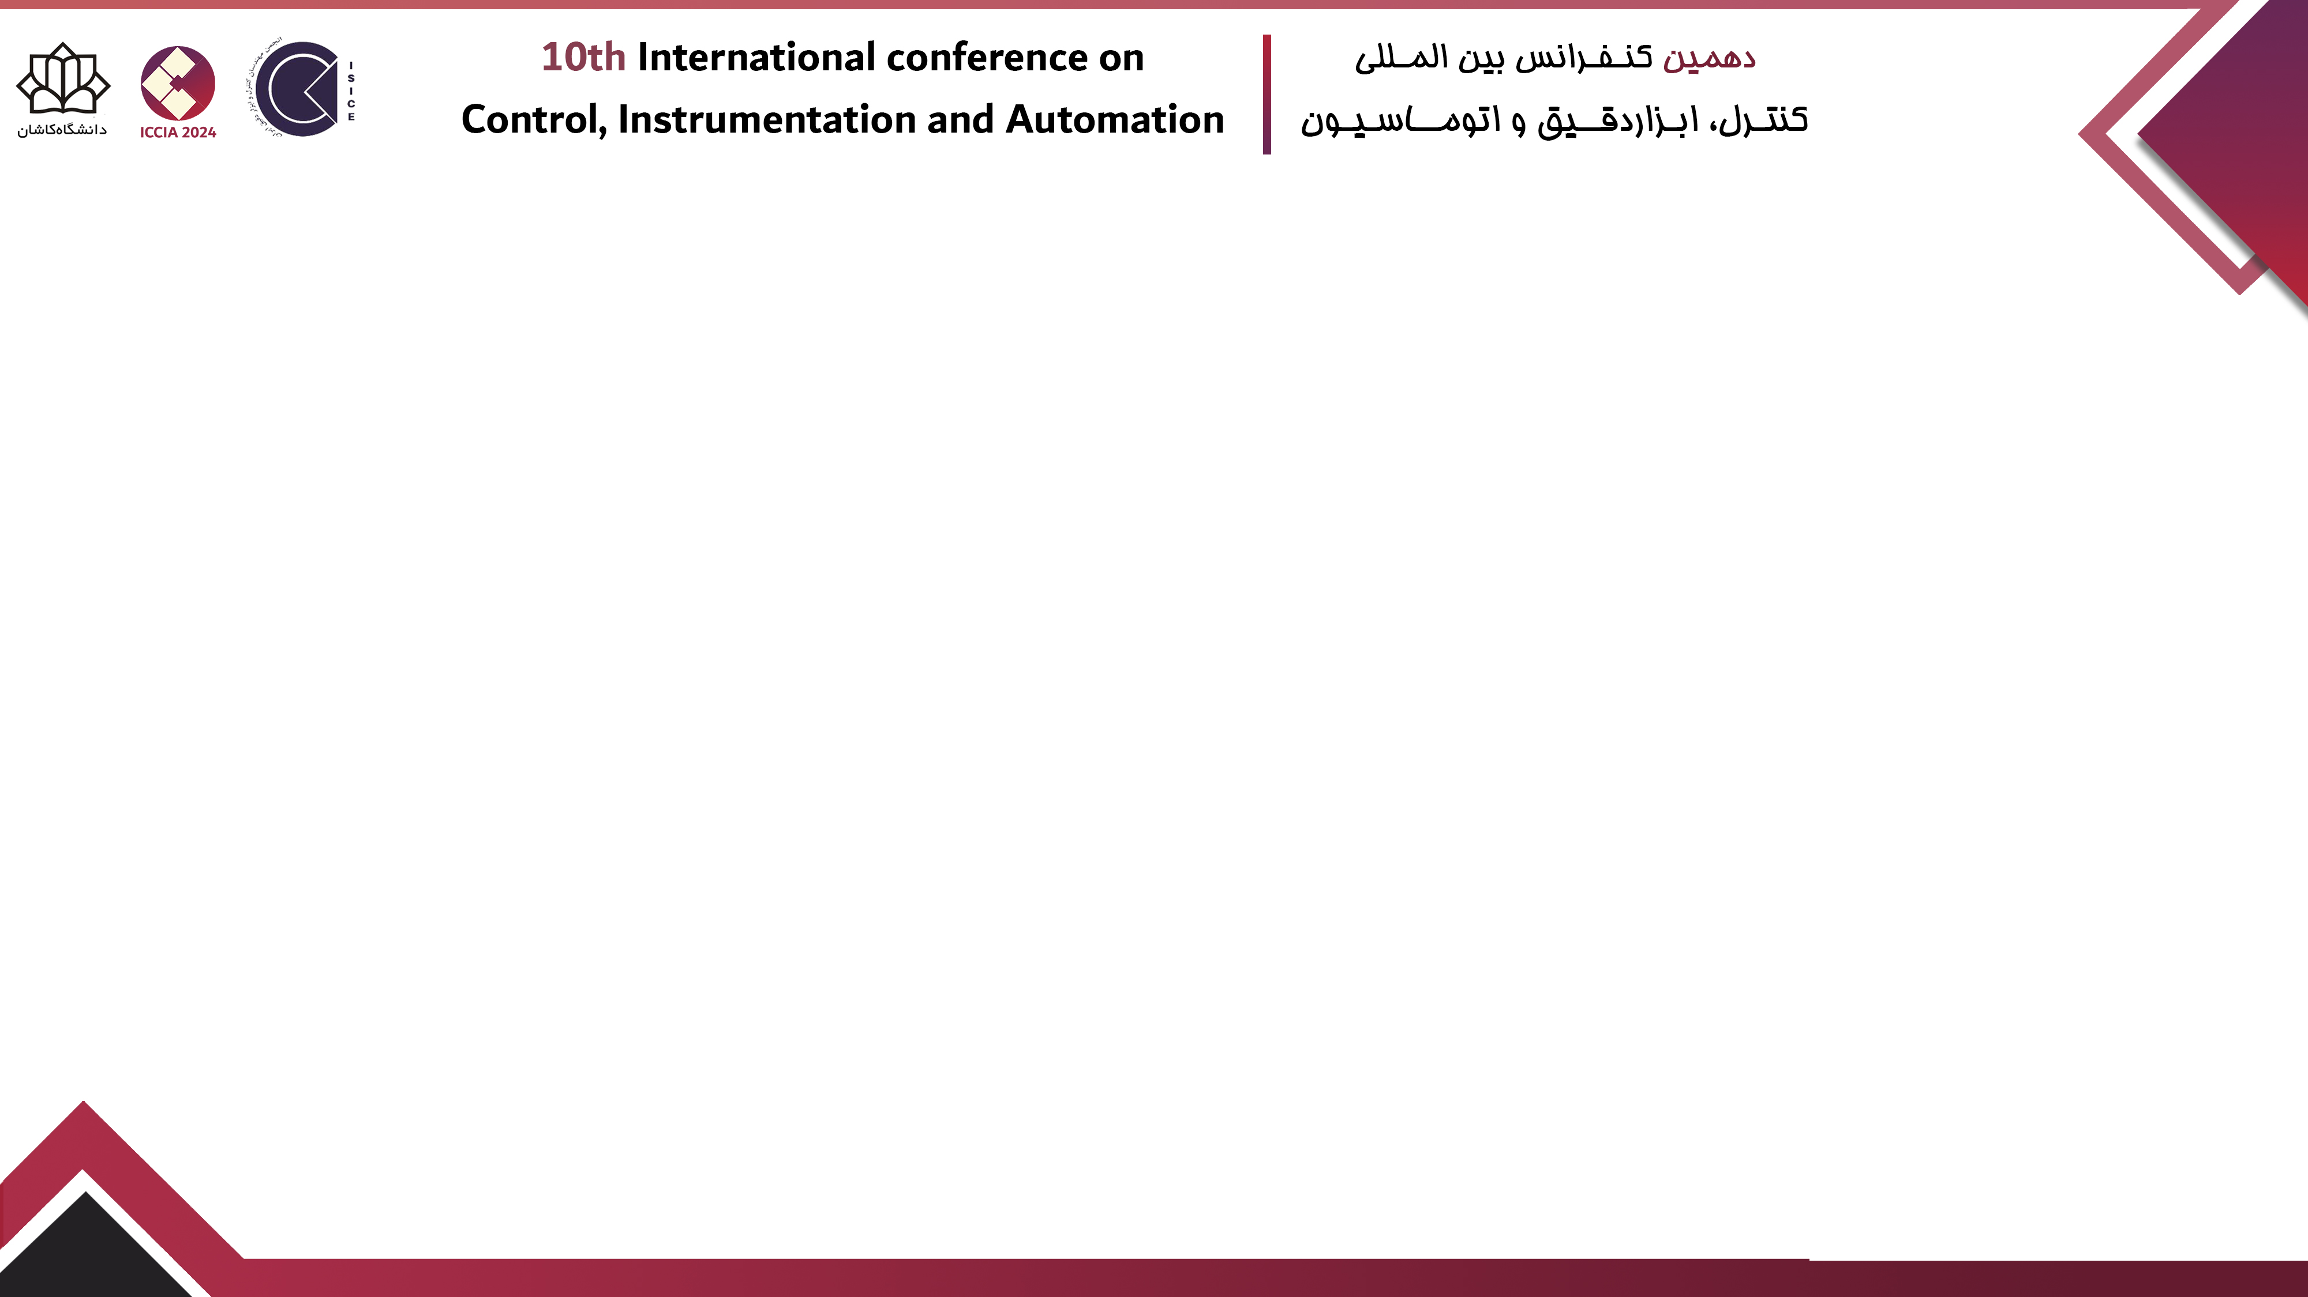
Paper Title
Authors’ names

Slide 2
Table of content
Tex
Introduction
Objectives & Innovations
Problem Formulation
Methodology & Solutions
Simulations
Conclusion

Slide 3

Table of content
Tex $\left[1\right]$
Introduction
Objectives & Innovations
Problem Formulation
Methodology & Solutions
Simulations
Conclusion
$\left[1\right]$ Y. Yorozu, M. Hirano, K. Oka, and Y. Tagawa, “Electron spectroscopy studies on magneto-optical media and plastic substrate interface,” IEEE Transl. J. Magn. Japan, vol. 2, pp. 740–741, August 1987 [Digests 9th Annual Conf. Magnetics Japan, p. 301, 1982].

Slide 4
Table of content
Tex
Introduction
Objectives & Innovations
Problem Formulation
Methodology & Solutions
Simulations
Conclusion

Slide 5
Table of content
Tex
Introduction
Objectives & Innovations
Problem Formulation
Methodology & Solutions
Simulations
Conclusion

Slide 6
Table of content
Tex
Introduction
Objectives & Innovations
Problem Formulation
Methodology & Solutions
Simulations
Conclusion

Slide 7
Table of content
Tex
Introduction
Objectives & Innovations
Problem Formulation
Methodology & Solutions
Simulations
Conclusion

Slide 8
Table of content
Tex
Introduction
Objectives & Innovations
Problem Formulation
Methodology & Solutions
Simulations
Conclusion

